Slide 1
Assembler Design Options
One-Pass and Multi-Pass Assemblers

Slide 2
One-Pass Assemblers
One-pass assemblers are used when
  it is necessary or desirable to avoid a second pass over the source program
  the external storage for the intermediate file between two passes is slow or is inconvenient to use
Main problem: forward references to both data and instructions
One simple way to eliminate this problem: require that all areas be defined before they are referenced.
  It is possible, although inconvenient, to do so for data items.
  Forward jump to instruction items cannot be easily eliminated.

Slide 3
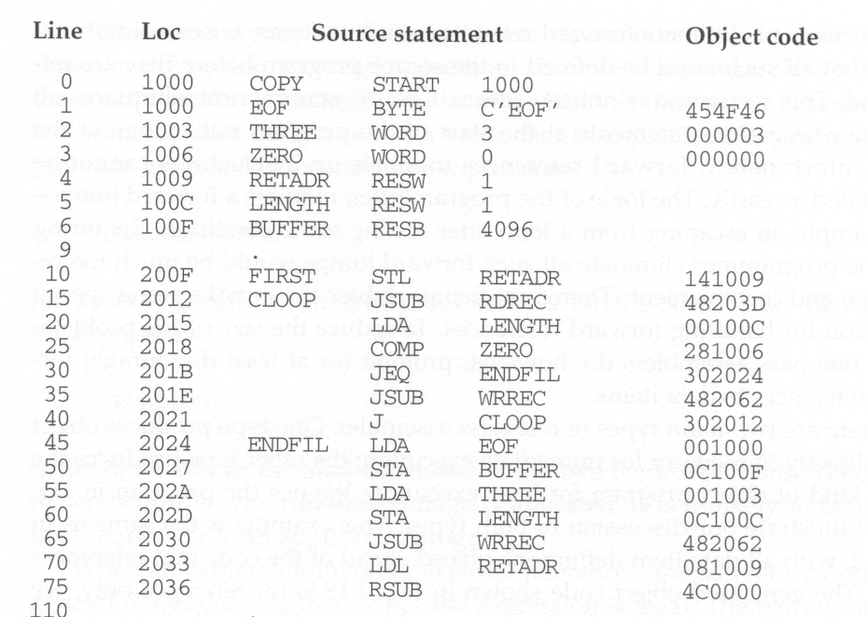
Sample Program for a One-Pass Assembler

Slide 4
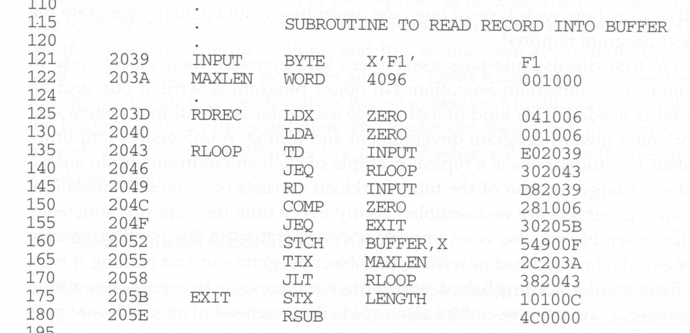
Sample Program for a One-Pass Assembler

Slide 5
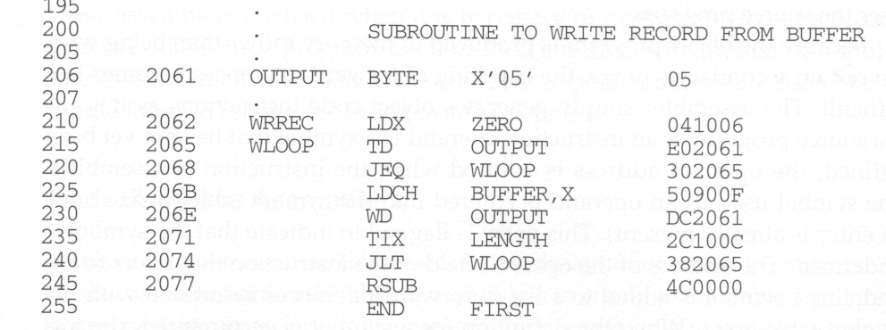
Sample Program for a One-Pass Assembler

Slide 6
Load-and-Go Assembler
Load-and-go assembler generates their object code in memory for immediate execution.
No object program is written out, no loader is needed.
It is useful in a system oriented toward program development and testing such that the efficiency of the assembly process is an important consideration.

Slide 7
How to Handle Forward References
Load-and-go assembler
  Omits the operand address if the symbol has not yet been defined
  Enters this undefined symbol into SYMTAB and indicates that it is undefined
  Adds the address of this operand address to a list of forward references associated with the SYMTAB entry
  Scans the reference list and inserts the address when the definition for the symbol is encountered.
  Reports the error if there are still SYMTAB entries indicated undefined symbols at the end of the program
  Search SYMTAB for the symbol named in the END statement and jumps to this location to begin execution if there is no error

Slide 8
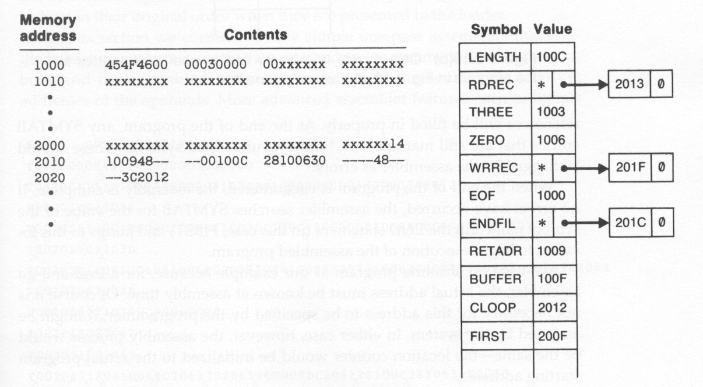
Object Code in Memory and SYMTAB
After scanning line 40

Slide 9
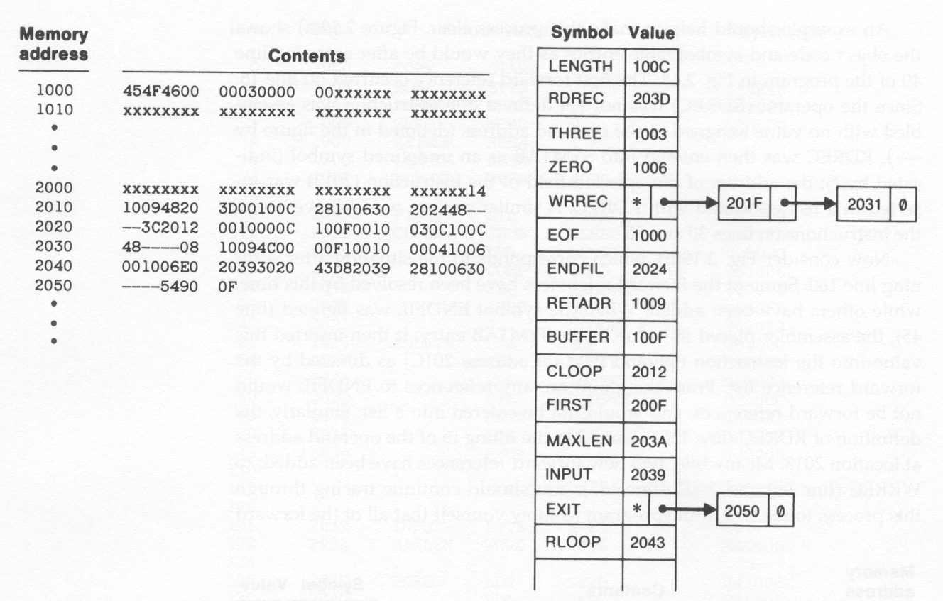
Object Code in Memory and SYMTAB
After scanning line 160

Slide 10
One-Pass Assembler that
Produce Object Programs
If the operand contains an undefined symbol, use 0 as the address and write the Text record to the object program.
Forward references are entered into lists as in the load-and-go assembler.
When the definition of a symbol is encountered, the assembler generates another Text record with the correct operand address of each entry in the reference list.
When loaded, the incorrect address 0 will be updated by the latter Text record containing the symbol definition.

Slide 11
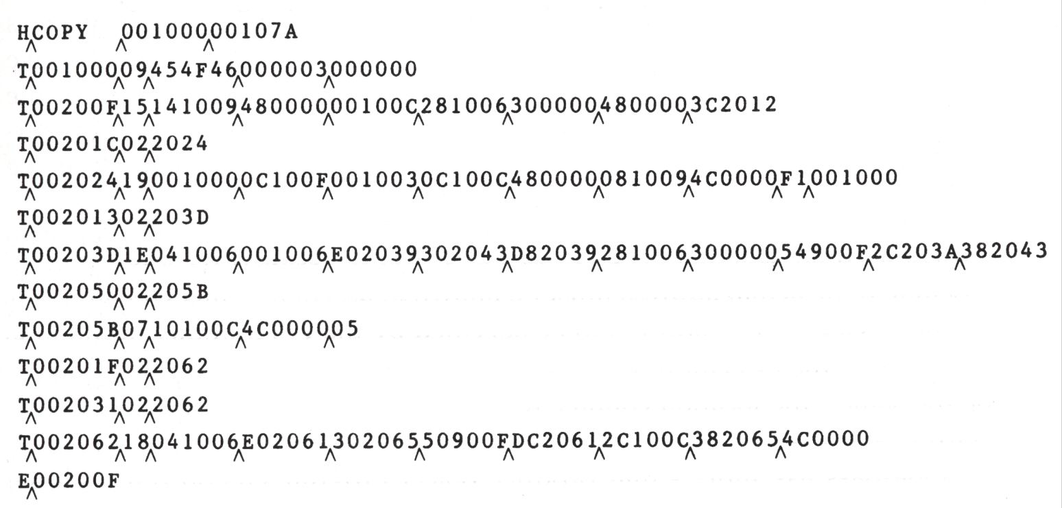
Object Program from One-Pass Assembler

Slide 12
Multi-Pass Assemblers
Prohibiting forward references in symbol definition:
  This restriction is not a serious inconvenience.
  Forward references tend to create difficulty for a person reading the program.
Allowing forward references
  To provide more flexibility
  Solution:
    A multi-pass assembler that can make as many passes as are needed to process the definitions of symbols.
    Only the portions of the program that involve forward references in symbol definition are saved for multi-pass reading.

Slide 13
Multi-Pass Assemblers
For a two pass assembler, forward references in symbol definition are not allowed:
ALPHA EQU BETA
BETA EQU DELTA
DELTA RESW 1
Reason: symbol definition must be completed in pass 1.
Motivation for using a multi-pass assembler
  DELTA can be defined in pass 1
  BETA can be defined in pass 2
  ALPHA can be defined in pass 3

Slide 14
Implementation
A symbol table is used
  to store symbol definitions that involve forward references
  to indicate which symbols are dependant on the values of others
  to facilitate symbol evaluation
For a forward reference in symbol definition, we store in the SYMTAB:
  the symbol name
  the defining expression
  the number of undefined symbols in the defining expression
  the undefined symbol (marked with a flag *) associated with a list of symbols depend on this undefined symbol.
When a symbol is defined, we can recursively evaluate the symbol expressions depending on the newly defined symbol.

Slide 15
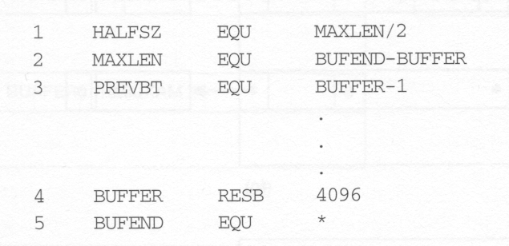
Forward Reference Example

Slide 16
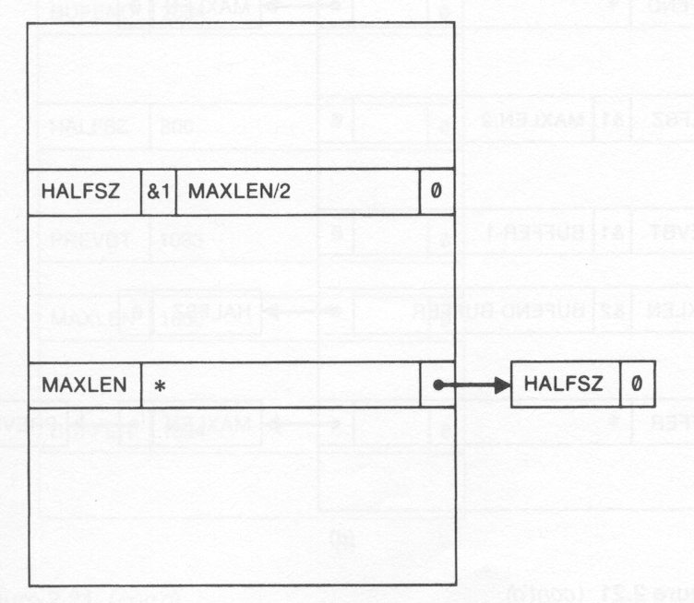
Forward Reference Example
1 HALFSZ EQU MAXLEN/2
one undefined symbol in the defining expression
defining expression
undefined symbol
depending list

Slide 17
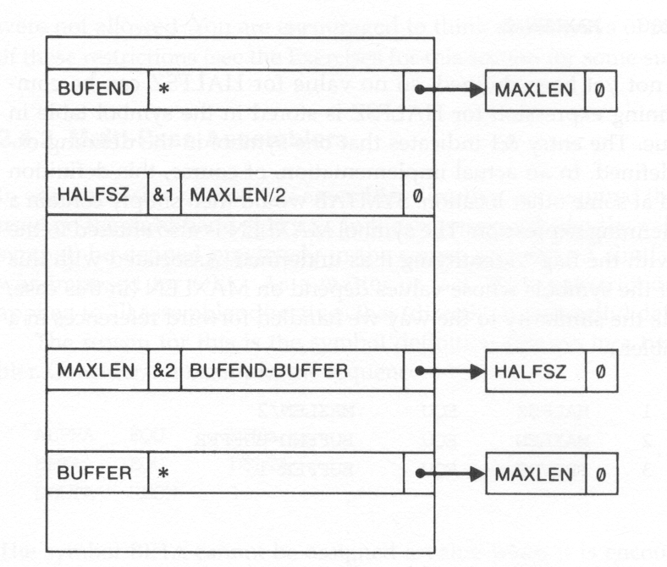
2 MAXLEN EQU BUFEND-BUFFER
undefined symbol
depending list
two undefined symbol in the defining expression
defining expression
undefined symbol
depending list

Slide 18
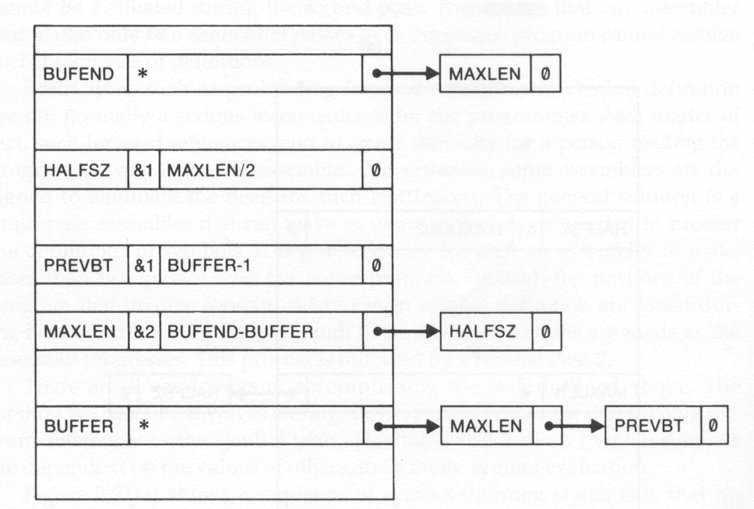
3 PREVBT EQU BUFFER-1
appended to the list

Slide 19
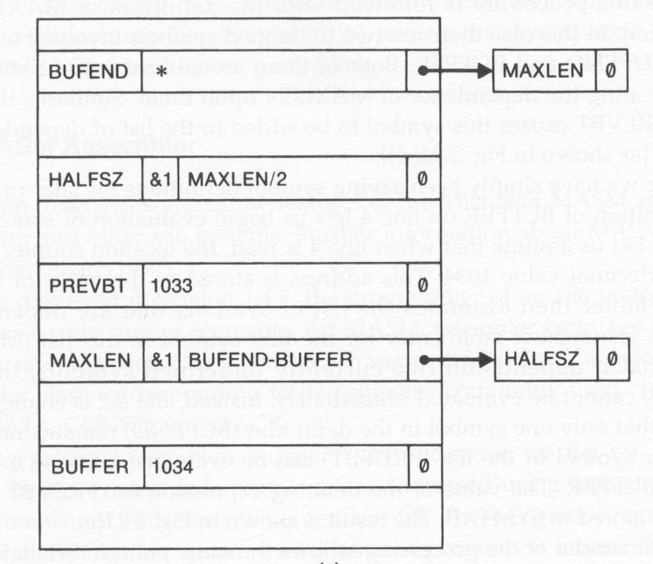
4 BUFFER RESB 4096

Slide 20
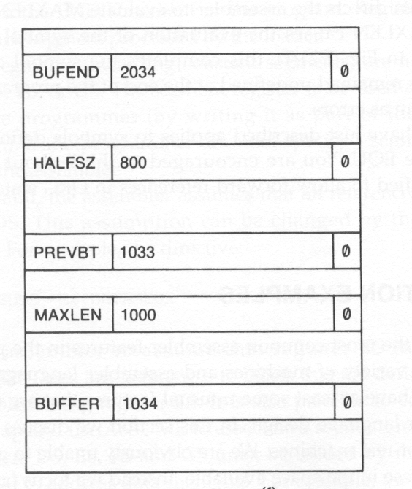
5 BUFEND EQU *

